Slide 1
TRUSTEE RECRUITMENT PACK
BECOMING PART OF THE TEMPO TEAM

Slide 2
Hello! We’re delighted that you are interested in joining our Board of Trustees here at Tempo Time Credits.
At Tempo, we’ve got a really important job to do. We galvanise communities to drive positive change for themselves and be more resilient through more individuals and more diverse groups of people volunteering.
We build self-sustaining communities created by resilient people.
Tempo Time Credits recognise and reward volunteers and help community development groups to retain them.
Tempo is passionate about the way Time Credits can be used to enable local communities to become strong and resilient. We do this by bringing together partnerships of local community development organisations. Tempo helps build and sustain these partnerships and Time Credits are the glue that hold these partnerships together.
We are ambitious for our future and can help build a strong, more diverse and resilient population of volunteers.
This pack is designed to help you get a feel for what it’s like to be a part of the Tempo team. It explains the process and will help you decide whether you can see yourself as a part of our fantastic team.

Slide 3
Who Are We?
FOUNDED: 2008… Our charity, Tempo, was founded to support and strengthen disconnected communities in the Welsh valleys using Time Credits. ‘Time Credits’ was initially developed to explore ways that alternative currencies could be used to help rebuild the ex-mining communities of South Wales. | OUR MODEL… Our model builds on the concept that time given can be exchanged. This concept was theorised and popularised by Teruko Mizushima in Japan in 1973 and developed further by human rights lawyer Edgar Cahn in 1986.
OUR FUTURE… We are expanding our geographical reach. We are now working in every part of Wales and in 7 of England’s 8 regions. We want to have full UK coverage by 2025 so that we can enable more people to contribute to their local community, and be recognised for the time that they give. To achieve this, we use Time Credits to engage new people in communities, broaden the demographic base of volunteering and shape local services, improving health and wellbeing for all.
OUR NUMBERS… Over 1 million Tempo Time Credits have been earned since 2008. We went digital in January and that number has grown by 90,000. Our staff work remotely, with a small office in Cardiff. | WE WORK WITH… Governments, Local Authorities, Clinical Commissioning Groups, Health Boards, Housing Providers, Health and Social Care Providers, Schools, Voluntary Organisations and Businesses.

Slide 4
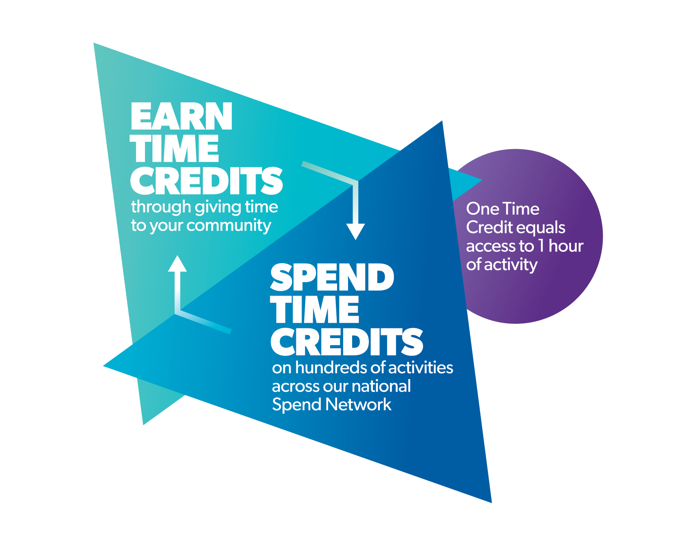
ABOUT US…
Our Strategic Objectives for 2020-2025 focus on what we do best. We want to expand our reach and provide a national service. The opening of the digital Time Credit platform at the beginning of 2021 made that possible.
The Time Credits model works simply: people earn Time Credits for each hour they volunteer. Our system records, recognises and rewards them. The reward is in the form of being able to use Tempo Time Credits at hundreds of different opportunities including local and national attractions, training courses, use of local leisure facilities, grocery and takeaway opportunities or they can be gifted to others.
Our local Time Credits programmes build connections at a local level by joining up the public, private and voluntary sectors in a Community.
Individuals earn Time Credits by volunteering.
We develop recognition partnerships with public, private and voluntary sectors that enable individuals to access a wide range of positive activities.
Recognition opportunities across our UK network can be accessed by volunteers by any volunteer, wherever they are.

Slide 5
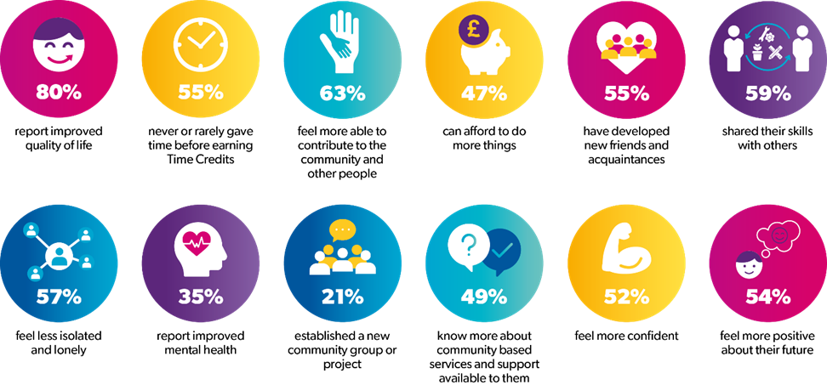
OUR IMPACT…
We are very proud to share our 2021 impact results which were analysed from data provided by people that participate in Time Credits Programmes. The quality and impact of our work grew during the Covid19 pandemic.
As seen in the fantastic array of results below, Time Credits continue to inspire people to give their time, make new friends and connections and learn more about the help available to them.

Slide 6
YOU AS A TRUSTEE
It is straightforward.
The Trustees
Set the vision and direction of the Charity through its strategic and business plans.
Approve and monitor the annual business plan and budget.
Make sure that the executive team is running the Charity properly and in accordance with Charity law.
Support the executive team with ideas, advice, expertise and experience.
Are responsible for ensuring the Charity is managed in accordance with Charity law and maintain the highest standards of governance.
There are 4 Board meetings a year, for two hours in the early evening. We also have an annual awayday to take stock of the longer term and more strategic issues (in London and costs are reimbursed). Each Trustee is also asked to support a specific workstream as a ‘critical friend’, according to their expertise. We conduct our meetings online to reduce our carbon footprint.

Slide 7
WHAT WE ARE LOOKING FOR
There is no typical profile for a Tempo Trustee. We’re interested in passionate individuals from a variety of backgrounds who will complement the skills and backgrounds of our current Board of Trustees.
Trustees do not need Board experience. Our current Trustees want to provide opportunities for people who have no or limited experience of Charity governance. They are committed to rebalancing the historic profile of the Board and will make time to nurture and make this happen.
We are particularly keen to hear from people who are experienced in the following areas:
Legal
Digital / Data / ICT
Brand and Marketing
Business Development and Sales

Slide 8
WHAT’S IN IT FOR YOU?
Tempo Trustees make a difference:
They work as a team. They are enthusiastic, motivated and have a diversity of perspectives
They support, generate ideas and are constructively critical of the executives
Use your skills and lived experience to make a lasting difference in our work.
Feel a sense of pride in having created and sustained increases in community resilience.
A FEW MORE DETAILS
Term of office – Trustees are appointed for a 3-year term initially, but there is an opportunity to pursue re-appointment with a maximum of 9 years on the Board.
Remuneration – Trustees serve as unpaid volunteers; however, reasonable expenses such as travel costs will be reimbursed.

Slide 9
HOW TO APPLY
Well, you’ve read a little bit about us so now it’s your turn!
To apply, please email recruitment@wearetempo.org with your CV and supporting statement outlining how you meet what we are looking for by 5pm on 8th December 2021. We will then shortlist and ask people to be interviewed. We will make this as informal as possible. You can find the role description here.
If you have no or limited experience of working as a Trustee, please do not be discouraged. We are looking for talented individuals who we can help develop. We would particularly welcome applications from groups in society that will bring us a different perspective and enhance the work of the Board of Trustees.
In our work we are diversifying the pool of volunteers. To reflect this our Trustees need to have a diversity of perspectives through your lived experience.
For an informal discussion about the role please contact Tempo’s CEO Mark Froud by emailing MarkFroud@wearetempo.org
Interviews will be held week commencing 6th December 2021.
“

Slide 10
Thank you for the interest you have shown in joining our team. Please send your CV and supporting statement to: recruitment@wearetempo.org

