Slide 1
Tempo Time Credits Impact 2022
London

Slide 2
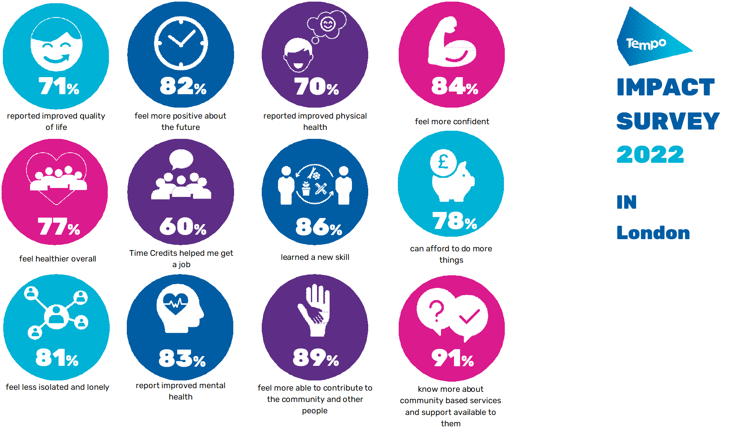
NET WELLBEING IMPACT IN LONDON
The economic impact (net wellbeing uplifts) of Tempo Time Credits (to the 419 volunteers earning them) is estimated at £3.1m (2019 prices). (Externally reviewed process)
69% of the community organisations that use Tempo Time Credits value their ability to recruit and retain volunteers This is estimated to have saved the 121 organisations using Tempo Time Credits £18,150 in the last year.

Slide 3
TIME CREDIT ACTIVITY
Tempo has multiple programmes in London. They are reported here and separately (Bexley, City of London, Haringey (3), Havering, Islington, Newham (2), Tower Hamlets, Westminster).
At the end of July 2022 the London programmes had 121 community groups participating with 1,998 volunteers. This is an average of 16.5 volunteers per community group (UK 10).
In the last 12 months 20,075 Tempo Time Credits were earned. This is an average of 10 Tempo Time Credits earned per volunteer (UK 11).
In London 165 Tempo Time Credits were earned per community group (UK 102).
There are 89 local recognition partners and 469 that are available in total.
In London 3,976 or 19.8% have been used (UK 16.6%). These numbers are growing quickly as recognition partners re-open and increase their volumes.

Slide 4
VOLUNTEERING ACTIVITY
Tempo Time Credit volunteers come from a diverse variety of economic backgrounds.
62% of those in the NCVO survey 2019 were in employment/self employment.
In London there are a higher number in self employment and less retired volunteers than the UK.
This reflects the higher level of selfemployment in London.

Slide 5
VOLUNTEERING TRENDS
12% of Tempo Time Credit volunteers in London have never volunteered before (UK 14%).
Unemployed and retired people are most likely to be new to volunteering.
74% of retired people have volunteered regularly or occasionally in the past compared to 60% of the other economic groups

Slide 6
VOLUNTEERING ACTIVITY
22% started or volunteer more due to Tempo Time Credits in London (UK 22%).
COVID-19 had a positive impact on volunteering. 40% of volunteers stated they had started (8%) or increased (32%) their volunteering in response to the pandemic.
This is 4% above the UK level.
Only 9% stated that they volunteered less.

Slide 7
QUALITY OF LIFE IMPACT
71% of London Tempo volunteers think that their quality of life has improved as a result of earning and using Tempo Time Credits compared to 70% of UK Tempo volunteers.
13% in London (12%UK) said that it has increased their quality of life a lot.

Slide 8
QUALITY OF LIFE IMPACT
London Tempo volunteers are marginally less positive than in the UK.
Tempo Time Credits have a positive impact in many ways, with each of these impacts scoring over 78% in London.
The positive impact on Tempo volunteers rose in 2022 by about 10%.
The ability to contribute to the local community (a key aspect of the Tempo programme) scored 89%.

Slide 9
HEALTH IMPACT
77% feel healthier (UK 79%).
Mental health benefits are stronger than physical health benefits.
Nearly 70% need to use their GP and social care services less. This will save these services money and reduce the pressure on service provision.

Slide 10
COMMUNITY IMPACT
Nearly 90% of Tempo volunteers are more able to understand and contribute to community development.
Over a quarter of Tempo volunteers are able to understand and contribute to community development a lot.
This aspect of community development is a major driver of the work Tempo does.

Slide 11
EMPLOYMENT IMPACT
In 2022 there was a significant growth in the positive impacts on employment and training from earning Tempo Time Credits.
London Tempo volunteers were more likely to get a job (60%) than the UK (57%).

Slide 12
IMPACT IN LONDON
The average Quality of Life score increased by 0.68 (6.25-6.93) between 2021 and 2022
Using a recognised methodology, we estimate the impact of volunteers earning Tempo Time Credits is £17.6m (0.68x£12,836x1,998 volunteers) at 2019 prices.
Based on the size of the quality of life change attributable to Tempo Time Credits, we estimate the impact of Tempo Time Credits is £3.1m.
We take a very cautious view and even by halving this figure the impact is £1.6m.
Note: Given the small sample size in London, the £ impact number is a guide only.

Slide 13
NET WELLBEING IMPACT IN LONDON
The economic impact (net wellbeing uplifts) of Tempo Time Credits (to the 419 volunteers earning them) is estimated at £3.1m (2019 prices). (Externally reviewed process)
69% of the community organisations that use Tempo Time Credits value their ability to recruit and retain volunteers This is estimated to have saved the 121 organisations using Tempo Time Credits £18,150 in the last year.

Slide 14
IMPACT ON COMMUNITY ORGANISATIONS
4 community organisations in London responded to the survey. The error margin is +/- 48%. The confidence level in the results is thus low and the UK results are reported here.
Community organisations on average deliver 4.6 different types of service to one or many groups in their community.
69% of organisations which use Tempo Time Credits value their ability to help recruit and retain volunteers.
It is estimated to have saved the 121 organisations using Tempo Time Credits £18,150 in the last year.
Tempo Time Credits help 36% of community organisations improve their volunteer diversity.

Slide 15
IMPACT ON COMMUNITY ORGANISATIONS
Over two thirds of community organisations using Tempo Time Credits reported they improved their health and wellbeing. This supports the findings of the survey of volunteers.
Only 69% of community organisations reported the improved skills and capabilities of their volunteers.
48% of community organisations reported improved working with other organisations.
35% of community organisations stated that having information from the system about their volunteers helped them raise more funding.

Slide 16
Tempo Time Credits Impact 2022
Full UK, Wales and topic reports
can be found at
www.wearetempo.org/impact-reports/

Slide 17
2022 IMPACT RESEARCH
Volunteer survey
Timescale March to June 2022
Potential respondents: 1,998 volunteers. 151 responses received (8%)
Error margin +/- 8% (at 95% confidence levels)
Responses analysed ignore: Don’t know and Not answered unless specified
Economic impact (net wellbeing uplifts) externally reviewed process
Community Group survey
Potential respondents: 121 community groups. 4 responses received (3%)
Error margin +/- 48% (at 95% confidence levels)
Responses analysed ignore: Don’t know and Not answered unless specified

