Slide 1
Tempo Time Credits Impact 2022
Medway

Slide 2
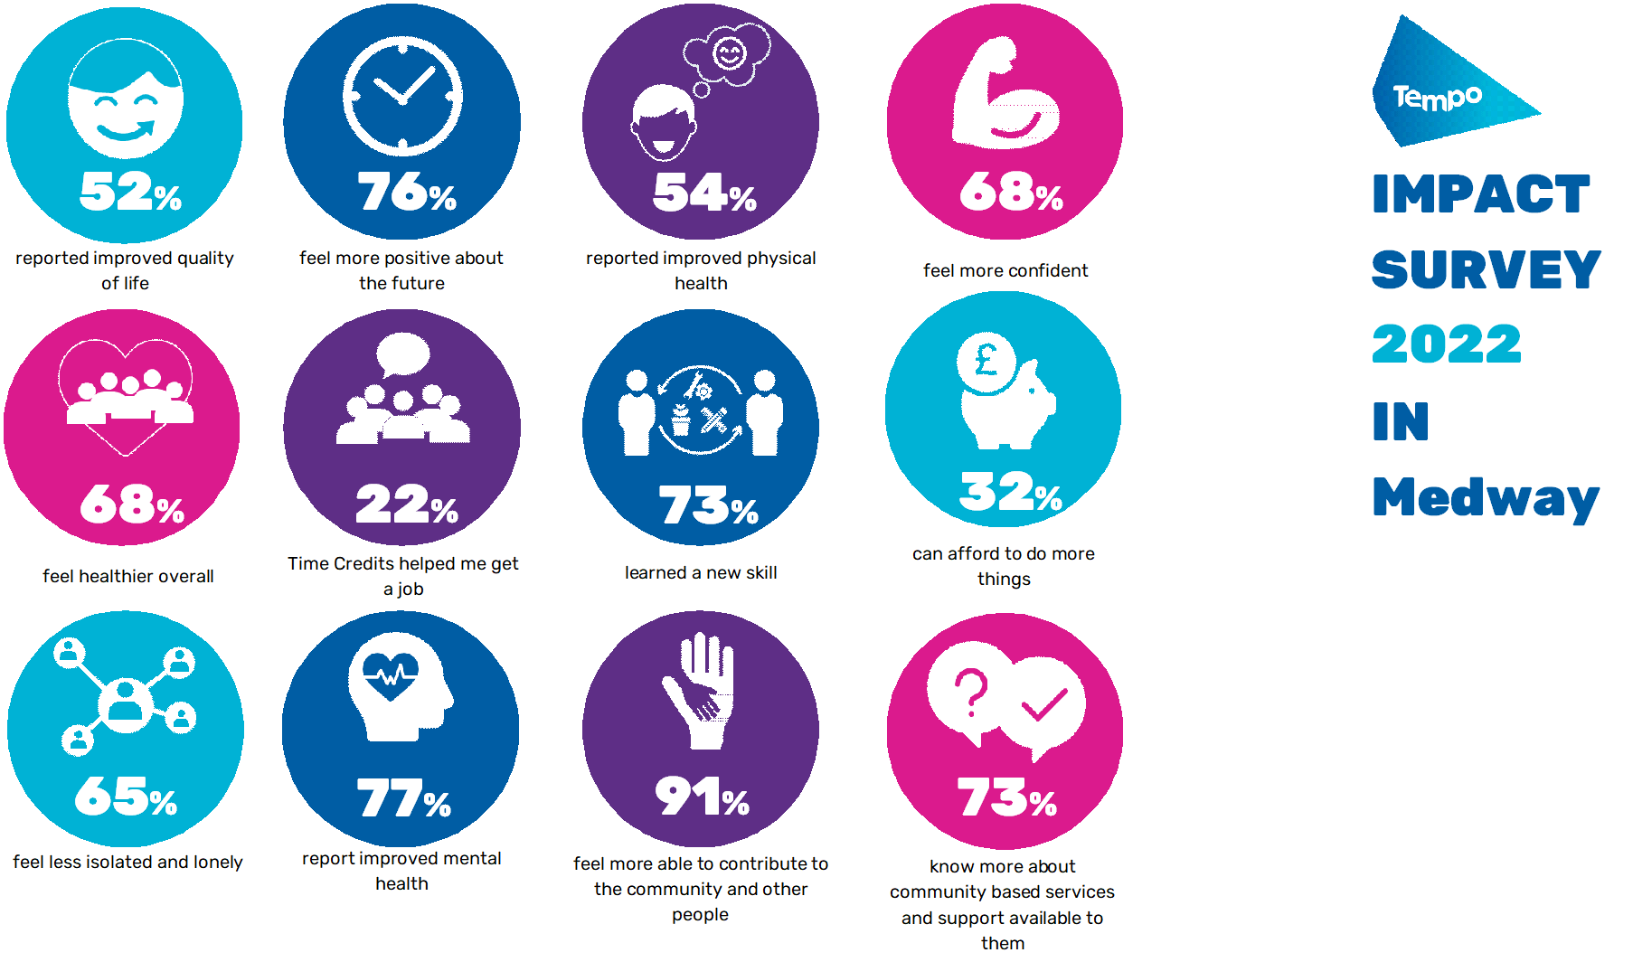
NET WELLBEING IMPACT IN MEDWAY
The economic impact (net wellbeing uplifts) of Tempo Time Credits (to the 513 volunteers earning them) is estimated at £362,000 (2019 prices). (Externally reviewed process)
69% of the community organisations that use Tempo Time Credits value their ability to recruit and retain volunteers This is estimated to have saved the 41 organisations using Tempo Time Credits £6,150 in the last year.

Slide 3
TIME CREDIT ACTIVITY
At the end of July 2022 the Medway programme had 41 community groups participating with 513 volunteers. This is an average of 12.5 volunteers per community group (UK 10).
In the last 12 months 8,028 Tempo Time Credits were earned. This is an average of 16 Tempo Time Credits earned per volunteer (UK 11).
In Medway 195 Tempo Time Credits were earned per community group (UK 102).
There are 8 local recognition partners and 469 that are available in total.
In Medway 995 or 12.3% have been used (UK 16.6%). These numbers are growing quickly as recognition partners re-open and increase their volumes.

Slide 4
VOLUNTEERING ACTIVITY
Tempo Time Credit volunteers come from a diverse variety of economic backgrounds.
62% of those in the NCVO survey 2019 were in employment/self employment.
In Medway there are a higher number unemployed and economically inactive than the UK.
This reflects the higher unemployment in Medway.

Slide 5
VOLUNTEERING TRENDS
18% of Tempo Time Credit volunteers in Medway have never volunteered before (UK 14%).
Unemployed and retired people are most likely to be new to volunteering.
74% of retired people have volunteered regularly or occasionally in the past compared to 60% of the other economic groups

Slide 6
VOLUNTEERING ACTIVITY
39% started or volunteer more due to Tempo Time Credits in Medway (UK 22%).
COVID-19 had a positive impact on volunteering. 40% of volunteers stated they had started (8%) or increased (32%) their volunteering in response to the pandemic.
This is 4% above the UK level, and reflects the lower level of volunteering in Medway pre pandemic.
Only 9% stated that they volunteered less.

Slide 7
QUALITY OF LIFE IMPACT
52% of Medway Tempo volunteers think that their quality of life has improved as a result of earning and using Tempo Time Credits compared to 70% of UK Tempo volunteers.
Only 3% in Medway (12%UK) said that it has increased their quality of life a lot.

Slide 8
QUALITY OF LIFE IMPACT
Medway Tempo volunteers are less positive than in the UK.
Tempo Time Credits have a positive impact in many ways, with each of these impacts scoring over 65% in Medway (except for being able to afford to do more).
The positive impact on Tempo volunteers rose in 2022 by about 10%.
The ability to contribute to the local community (a key aspect of the Tempo programme) scored 91%.

Slide 9
HEALTH IMPACT
68% feel healthier (UK 79%).
Mental health benefits are stronger than physical health benefits.
Nearly 50% need to use their GP less and 35% need to use social care services less. This will save these services money and reduce the pressure on service provision.

Slide 10
COMMUNITY IMPACT
Over 70% of Tempo volunteers are more able to understand and contribute to community development.
35% of Tempo volunteers are able to contribute to community development a lot.
This aspect of community development is a major driver of the work Tempo does.

Slide 11
EMPLOYMENT IMPACT
In 2022 there was a significant growth in the positive impacts on employment and training from earning Tempo Time Credits.
Medway Tempo volunteers were less likely to get a job (22%) than the UK (57%).

Slide 12
IMPACT IN Medway
The average Quality of Life score increased by 0.59 (6.41-7.00) between 2021 and 2022
Using a recognised methodology, we estimate the impact of volunteers earning Tempo Time Credits is £4.7m (0.59x£12,836x513 volunteers) at 2019 prices.
Based on the size of the quality of life change attributable to Tempo Time Credits, we estimate the impact of Tempo Time Credits is £362,000.
We take a very cautious view and even by halving this figure the impact is £181,000.
Note: Given the small sample size in Medway, the £ impact number is a guide only.

Slide 13
NET WELLBEING IMPACT IN MEDWAY
The economic impact (net wellbeing uplifts) of Tempo Time Credits (to the 513 volunteers earning them) is estimated at £362,000 (2019 prices). (Externally reviewed process)
69% of the community organisations that use Tempo Time Credits value their ability to recruit and retain volunteers This is estimated to have saved the 41 organisations using Tempo Time Credits £6,150 in the last year.

Slide 14
IMPACT ON COMMUNITY ORGANISATIONS
Only 5 community organisations in Medway responded to the survey, so the UK data is shown here as the error margin (+/- 42% is too great to be valid).
Community organisations on average deliver 4.6 different types of service to one or many groups in their community.
69% of organisations which use Tempo Time Credits value their ability to help recruit and retain volunteers.
It is estimated to have saved the 84 organisations using Tempo Time Credits £12,600 in the last year.
Tempo Time Credits help 36% of community organisations improve their volunteer diversity.

Slide 15
IMPACT ON COMMUNITY ORGANISATIONS
Over two-thirds of community organisations using Tempo Time Credits reported they improved volunteer skills and their health and wellbeing. This supports the findings of the survey of volunteers.
35% of community organisations stated that having information from the system about their volunteers helped them raise more funding.

Slide 16
Tempo Time Credits Impact 2022
Full UK, Wales and topic reports
can be found at
www.wearetempo.org/impact-reports/

Slide 17
2022 IMPACT RESEARCH
Volunteer survey
Timescale March to June 2022
Potential respondents: 513 volunteers. 34 responses received (7%)
Error margin +/- 16% (at 95% confidence levels)
Responses analysed ignore: Don’t know and Not answered unless specified
Economic impact (net wellbeing uplifts) externally reviewed process
Community Group survey
Potential respondents: 41 community groups. 6 responses received (13%)
Error margin +/- 38% (at 95% confidence levels)
Responses analysed ignore: Don’t know and Not answered unless specified

